Slide 1
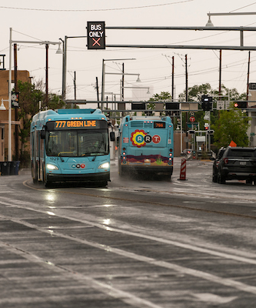
MONTHLY INFORMATIONAL REPORT
JANUARY 2023
JANUARY RIDERSHIP
NOVEMBER
DECEMBER
JANUARY
PAGE 1

Slide 2
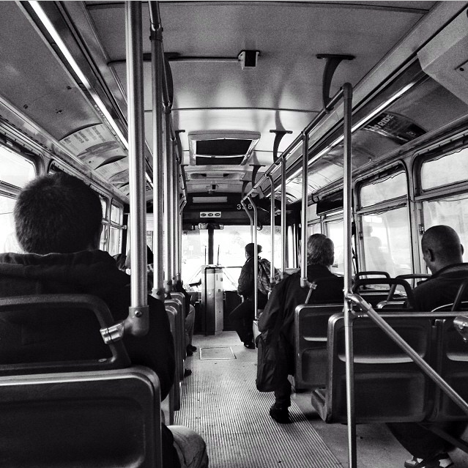
RIDERSHIP
Fixed Route Ridership
Month | FY19 | FY20 | FY21 | FY22 | FY23
JUL | 781,280 | 755,491 | 370,222 | 393,282 | 525,529
AUG | 880,079 | 805,880 | 333,389 | 395,706 | 589,100
SEP | 795,408 | 770,017 | 349,035 | 389,426 | 508,877
OCT | 837,665 | 815,378 | 378,371 | 438,310 | 563,424
NOV | 758,173 | 694,714 | 295,324 | 418,177 | 540,232
DEC | 670,554 | 746,344 | 276,468 | 387,785 | 579,365
JAN | 716,045 | 729,005 | 275,283 | 422,724 | 547,662
FEB | 698,976 | 764,293 | 275,242 | 401,963
MAR | 757,396 | 630,292 | 356,489 | 469,247
APR | 779,357 | 315,901 | 356,158 | 458,194
MAY | 755,731 | 306,544 | 345,151 | 462,601
JUN | 729,045 | 336,563 | 365,471 | 477,309
Total | 9,159,709 | 7,670,422 | 3,976,603 | 5,114,724 | 3,854,189
24.52% decrease from December, 2022
3.45% increase from January, 2022
MONTHLY INFORMATIONAL REPORT | JANUARY 2023
PAGE 2

Slide 3
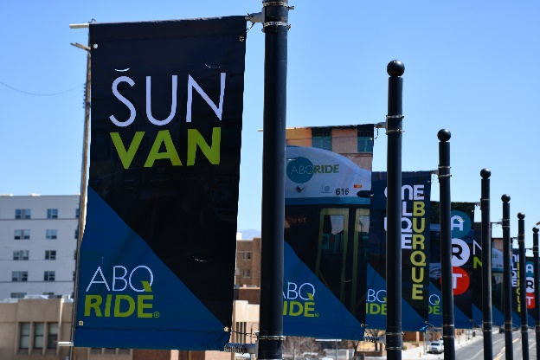
PARATRANSIT/SUN VAN
4.55% increase from December 2022
23.13% increase from January 2022
Paratransit (Sun Van) Ridership
Month | FY19 | FY20 | FY21 | FY22 | FY23
Jul | 20,659 | 20,732 | 6,786 | 10,901 | 13,623
Aug | 23,534 | 22,168 | 7,031 | 12,623 | 16,343
Sep | 21,363 | 21,228 | 7,127 | 13,165 | 15,423
Oct | 24,424 | 23,554 | 7,479 | 14,007 | 15,611
Nov | 21,388 | 19,867 | 5,800 | 12,727 | 13,002
Dec | 19,004 | 19,496 | 6,094 | 12,097 | 14,208
Jan | 22,085 | 21,475 | 6,331 | 12,064 | 14,855
Feb | 20,686 | 20,618 | 6,179 | 11,874
Mar | 21,993 | 12,795 | 8,165 | 14,412
Apr | 22,936 | 3,809 | 9,589 | 14,395
May | 20,937 | 4,296 | 9,519 | 14,267
Jun | 19,741 | 6,348 | 10,215 | 13,756
Total | 258,750 | 196,386 | 90,315 | 156,288 | 105,012
Sun Van Applications
Month | FY19 | FY20 | FY21 | FY22 | FY23
Jul | 78 | 76 | 18 | 37 | 59
Aug | 91 | 91 | 22 | 86 | 50
Sep | 67 | 82 | 26 | 67 | 105
Oct | 90 | 88 | 32 | 58 | 95
Nov | 63 | 72 | 25 | 39 | 104
Dec | 66 | 84 | 19 | 44 | 32
Jan | 70 | 64 | 20 | 37 | 52
Feb | 91 | 75 | 29 | 50
Mar | 83 | 42 | 34 | 44
Apr | 94 | 7 | 47 | 37
May | 112 | 20 | 37 | 93
Jun | 89 | 30 | 67 | 64
Total | 994 | 731 | 376 | 656 | 497
MONTHLY INFORMATIONAL REPORT | JANUARY 2023
PAGE 3

Slide 4
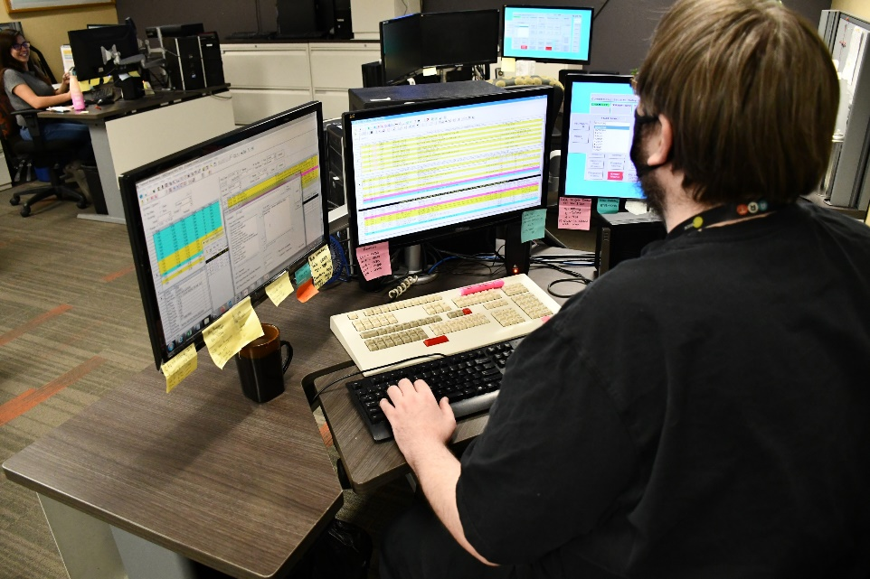
CUSTOMER SERVICE
Month | Plan Your Ride |  |  | Sun Van Reservations |  |  | Total Calls
 | Calls Presented | Calls Handled | % | Calls Presented | Calls Handled | % | Calls Presented | Calls Handled | %
JUL | 2,043 | 1,477 | 72.3 | 13,712 | 12,340 | 89.99 | 15,755 | 13,817 | 87.7
AUG | 2,112 | 1,229 | 58.19 | 16,288 | 13,864 | 85.12 | 18,400 | 15,093 | 82.02
SEP | 2,268 | 911 | 40.17 | 16,795 | 12,609 | 75.08 | 19,063 | 13,520 | 70.92
OCT | 1,856 | 1,029 | 55.44 | 15,653 | 13,160 | 84.07 | 17,509 | 14,189 | 81.03
NOV | 1,449 | 946 | 65.29 | 13,108 | 11,701 | 89.27 | 14,557 | 12,647 | 86.88
DEC | 1,627 | 1,231 | 75.66 | 13,985 | 12,752 | 91.18 | 15,612 | 13,983 | 89.56
JAN | 1,783 | 1,423 | 79.81 | 16,680 | 15,603 | 93.54 | 18,463 | 17,026 | 92.21
MONTHLY INFORMATIONAL REPORT | JANUARY 2023
PAGE 4

Slide 5
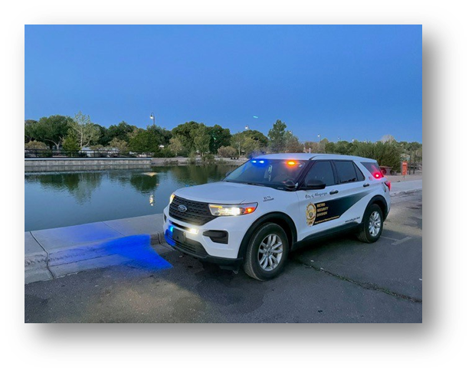
SECURITY
Month | Total Security Calls | Security Check
Jul | 260 | 466
Aug | 245 | 432
Sep | 247 | 444
Oct | 271 | 483
Nov | 294 | 544
Dec | 354 | 597
Jan | 473 | 703
*Security Checks include officers conducting proactive/routine checks of Transit facilities (bus stops, transit centers) to ensure these areas remain safe.
MONTHLY INFORMATIONAL REPORT | JANUARY 2023
PAGE 5

Slide 6
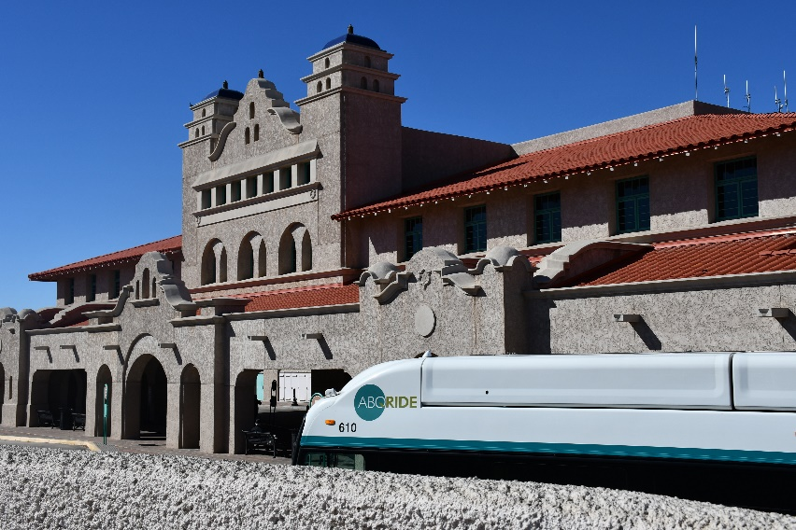
SECURITY CALLS BY LOCATION
January
December
November
MONTHLY INFORMATIONAL REPORT | JANUARY 2023
PAGE 6

Slide 7
SECURITY CALLS BY LOCATION
Figure S1
FY23 | ATC | CUTC | MTC | NWTC | UTC | Yale | Daytona | Tramway/Wenonah
JUL | 235 | 76 | 15 | 16 | 76 | 35 | 32 | 49
AUG | 332 | 72 | 1 | 4 | 83 | 17 | 14 | 20
SEP | 274 | 57 | 2 | 8 | 82 | 9 | 10 | 31
OCT | 273 | 78 | 2 | 4 | 81 | 21 | 14 | 35
NOV | 420 | 81 | 1 | 4 | 81 | 6 | 11 | 28
DEC | 441 | 121 | 0 | 7 | 96 | 6 | 16 | 43
JAN | 46 | 35 | 0 | 4 | 14 | 2 | 1 | 8
Figure S2
FY23 | Route 1 | Route 2 | Route 5 | Route 8 | Route 10 | Route 11 | Route 16 | Route 31 | Route 50 | Route 53/54 | Route 66 | Route 140/141 | Route 155 | Route 157 | Route 766/777
JUL | 0 | 0 | 7 | 5 | 6 | 4 | 2 | 2 | 0 | 1 | 31 | 4 | 0 | 2 | 52
AUG | 0 | 1 | 1 | 2 | 6 | 3 | 0 | 1 | 1 | 2 | 57 | 3 | 3 | 2 | 46
SEP | 0 | 0 | 4 | 8 | 6 | 5 | 5 | 1 | 0 | 2 | 80 | 4 | 4 | 1 | 77
OCT | 2 | 0 | 8 | 0 | 0 | 4 | 4 | 1 | 0 | 1 | 90 | 5 | 5 | 2 | 96
NOV | 0 | 0 | 3 | 7 | 3 | 5 | 1 | 4 | 0 | 0 | 80 | 5 | 3 | 3 | 100
DEC | 0 | 1 | 7 | 4 | 1 | 1 | 0 | 1 | 2 | 0 | 52 | 10 | 10 | 2 | 117
JAN | 1 | 1 | 2 | 0 | 4 | 3 | 1 | 0 | 0 | 1 | 108 | 6 | 11 | 0 | 86
MONTHLY INFORMATIONAL REPORT | JANUARY 2023
PAGE 7

Slide 8
SECURITY CALLS BY TYPE
 | Assault | Fight | Fire | Mental Health | Traffic | Trespass | Vandal | Suspicious Situation
JUL | 0 | 8 | 1 | 1 | 2 | 3 | 3 | 8
AUG | 1 | 7 | 0 | 0 | 0 | 2 | 5 | 31
SEP | 3 | 5 | 1 | 0 | 0 | 7 | 3 | 19
OCT | 0 | 9 | 3 | 1 | 3 | 1 | 2 | 10
NOV | 3 | 4 | 4 | 1 | 5 | 2 | 1 | 5
DEC | 3 | 3 | 3 | 0 | 1 | 1 | 3 | 11
JAN | 1 | 12 | 4 | 0 | 0 | 2 | 1 | 10
FEB
MAR
APR
MAY
JUN
FY23 | Intoxicated | Other | Narcotics | Disorderly Conduct | Loitering | Wellness/ Medical
JUL | 10 | 57 | 16 | 40 | 41 | 70
AUG | 16 | 29 | 33 | 27 | 49 | 45
SEP | 12 | 13 | 22 | 29 | 68 | 65
OCT | 16 | 7 | 30 | 46 | 93 | 50
NOV | 16 | 12 | 31 | 40 | 119 | 51
DEC | 13 | 16 | 53 | 49 | 116 | 64
JAN | 14 | 16 | 61 | 61 | 179 | 63
FEB
MAR
APR
MAY
JUN
MONTHLY INFORMATIONAL REPORT | JANUARY 2023
PAGE 8

Slide 9
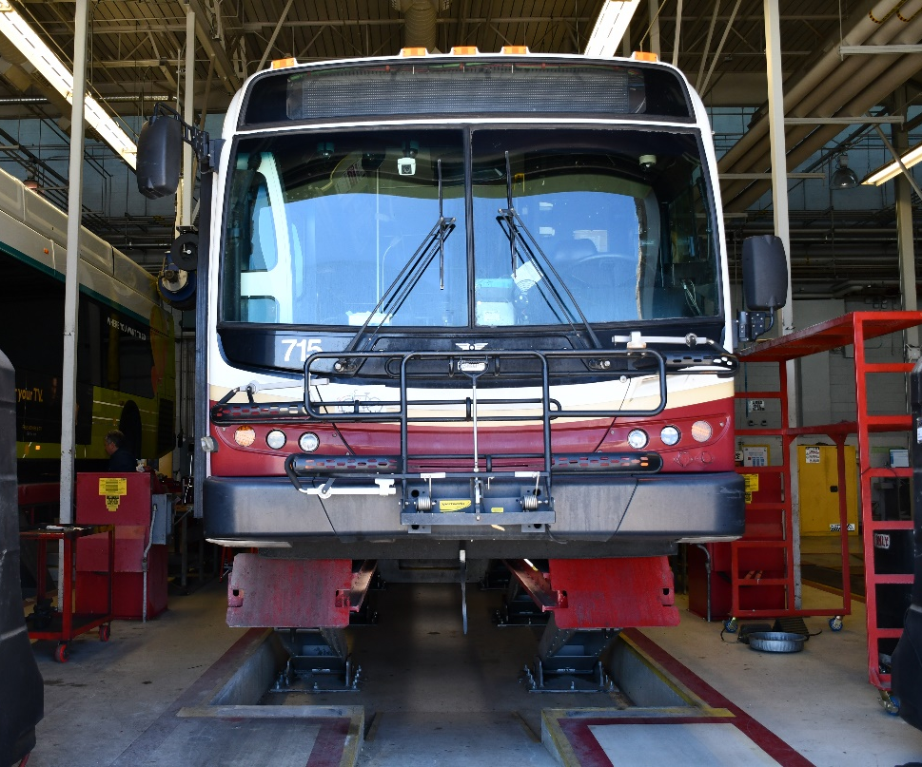
UPDATES
Completed roof and interior repairs to Curio Building
Hired 2 Mechanics and 3 Parts Workers
Participated in Albuquerque Comic Con
Launched “Reasons To Ride” social media campaign
Customer Service Representatives handled % more calls in January 2023 than December 2022.
Hired 9 new Motorcoach Operators and 6 new Sun Van Chauffeurs.
MONTHLY INFORMATIONAL REPORT | JANUARY 2023
PAGE 9

